Slide 1
MEMORIALS
Memorials are built to help people remember the past.
Notes:
The word “memorial” has the same root as the words memory and remember.

Slide 2
Memorials are built from different points of view.
Memorials built by victims
Memorials built by the responsible groups
Notes:
This is one way to think about the differences between memorials.

Slide 3
Memorials built by victims:
Someone did something bad to us
*most of memorials are made from the point of view of the victims.

Slide 4
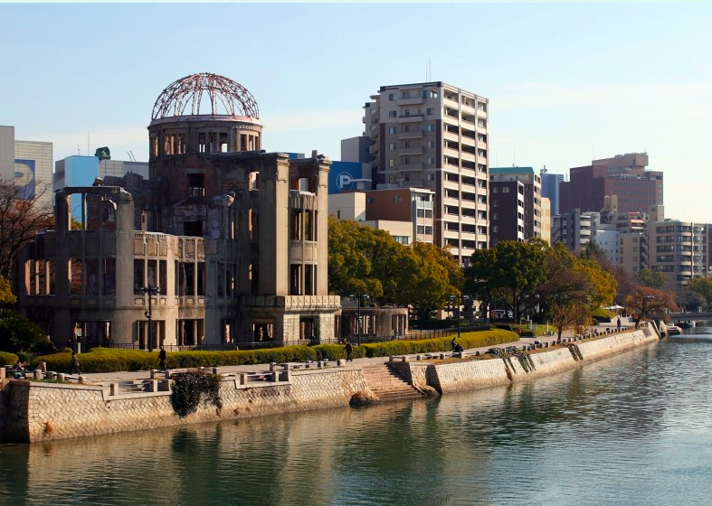
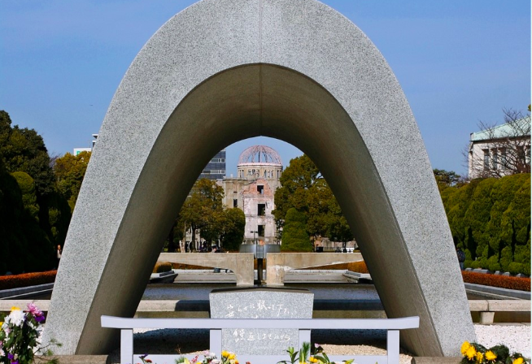
Hiroshima Peace Park

Slide 5
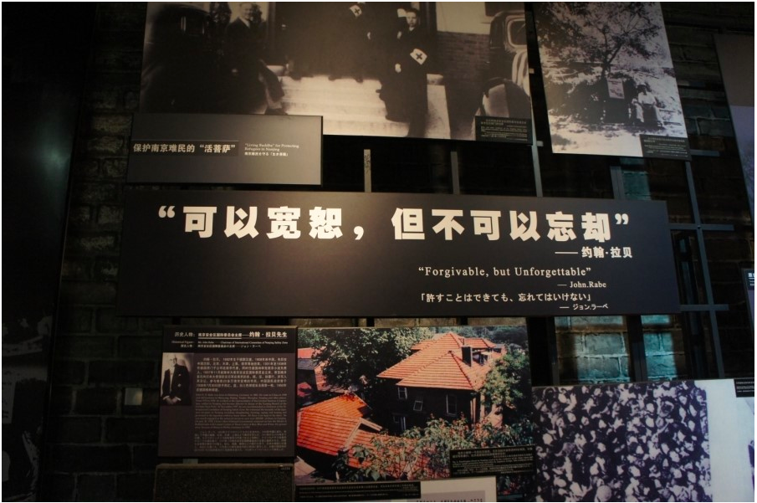
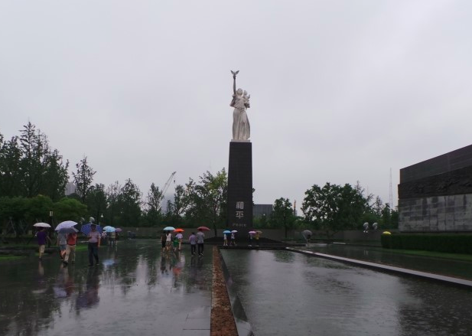
Nanjing Massacre Museum

Slide 6
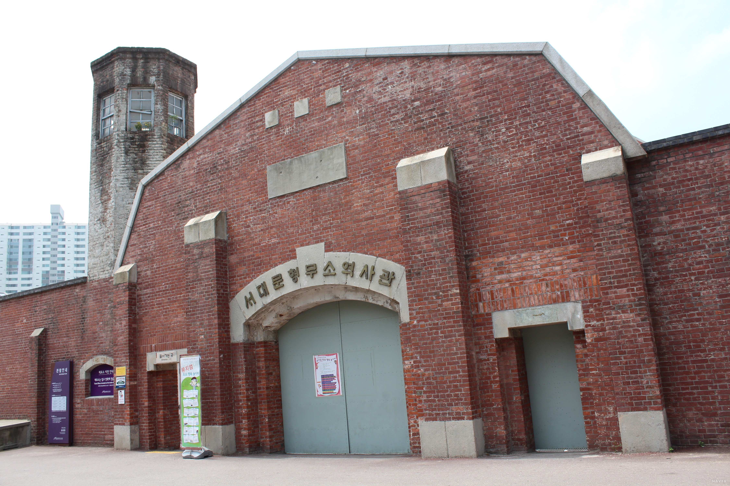
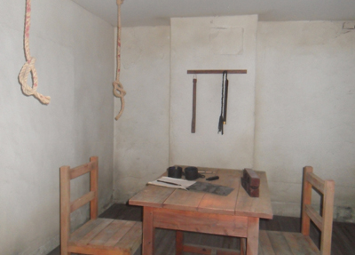
Seodaimun Prison History Hall

Slide 7
Memorials built by the responsible groups
We did it
We are sorry
The memorial shows regret
* This type of memorial shows that a country regrets doing something wrong. They know they were responsible and they are sorry. There are not as many memorials like this because it is often difficult for powerful countries to admit that they did something wrong . It is easier to make memorial s about being a victim. It’s easier to say someone else did something bad to us, rather than admitting we did something wrong.

Slide 8
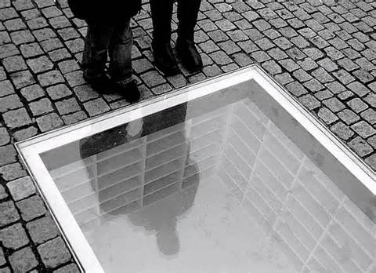
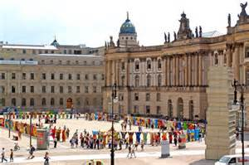
Bebelplatz Square in Berlin
“Where they burn books, they will in the end also burn people.”

Slide 9
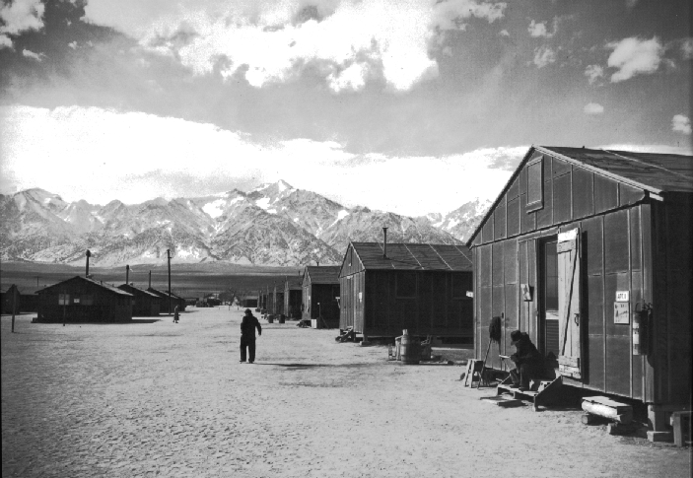
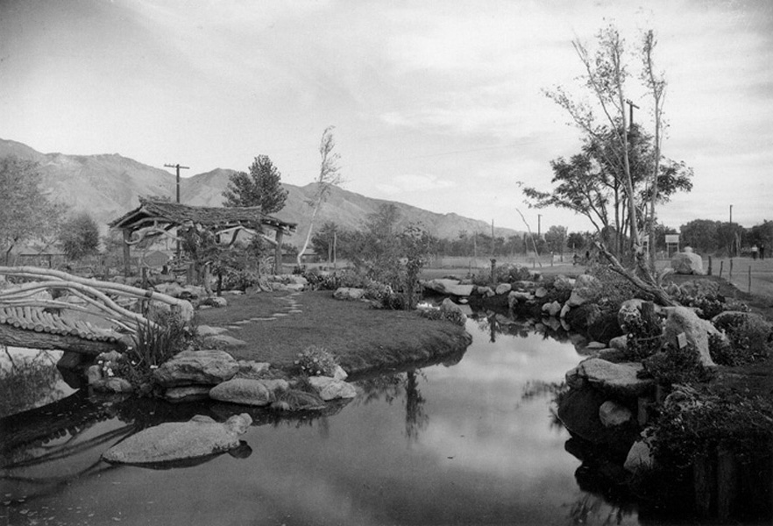
Manzanar

Slide 10
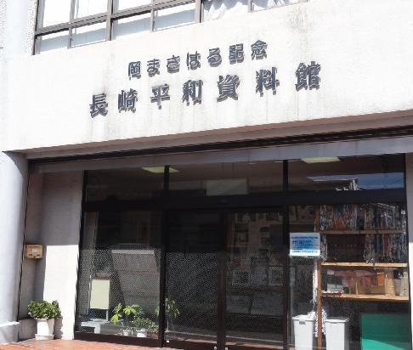
Oka Masaharu Memorial
(Nagasaki Peace Museum)
Korean Atomic bomb survivors
Aggression in Korea and China
Japanese army’s slavery (Comfort women)
Forced labor
Hashima island
Postwar compensation
The truth of “the sphere of co-prosperity in East Asia”

Slide 11
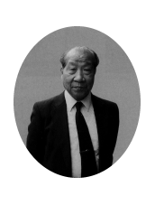
Mr. Oka Masaharu
Pastor, Lawyer, the member of city assembly
He devoted himself to found a museum to inform the truth of aggression to reveal Japanese government’s responsibility to abolish discrimination against Korea and to make the government do compensate for war victims. Unfortunately, he suddenly died on July 21, 1994.
Some people sympathized with his idea gathered to make a museum. They started with no building, no money. Nevertheless they could solve those difficult problem.

Slide 12
Purposes of memorials
Positive purposes
Negative purposes
Remember history
Honor victims
Say, “I’m sorry”
Warning: “Never again”
Imagine a peaceful future
Educate people to feel:
  Hatred
  Fear
  Revenge
* Many memorials don’t have just one purpose, but have many purposes. They might honor the victims but also educate people to feel hatred. For example…

Slide 13
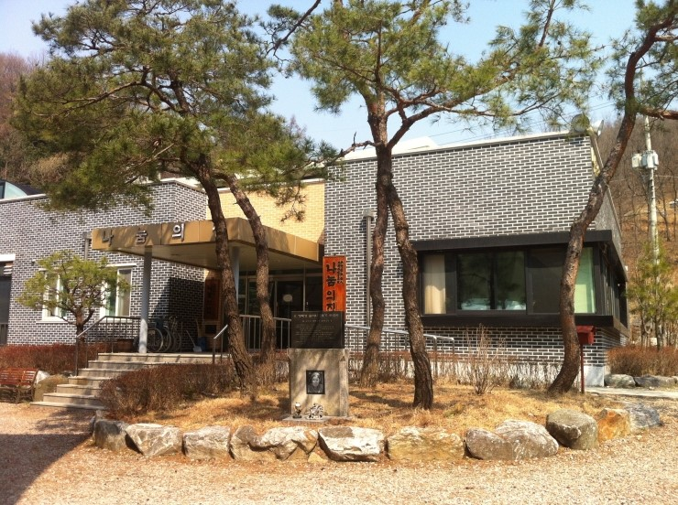

Our visit on Tuesday:

Slide 14
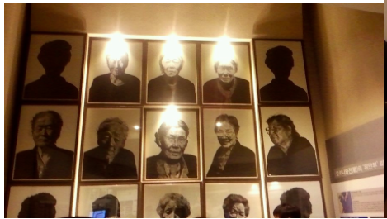
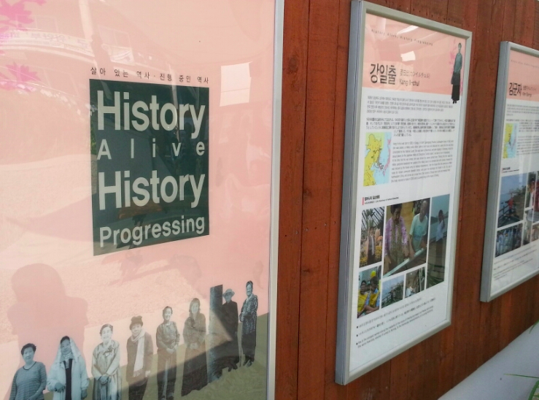
Photos and items from daily life

Slide 15
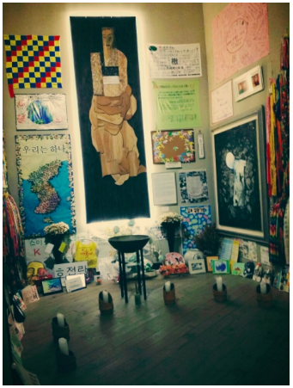
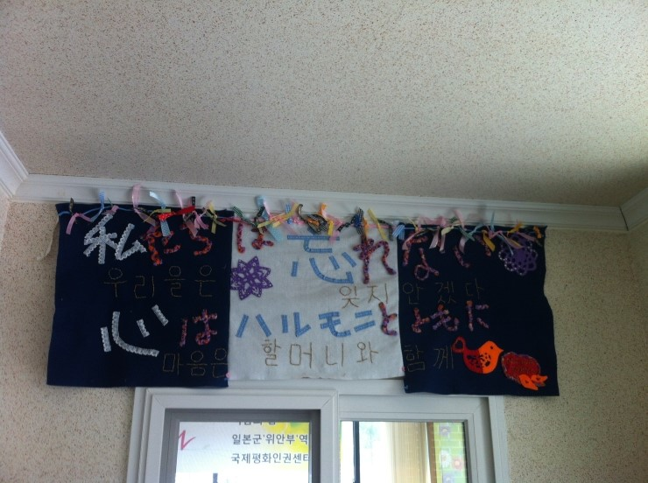
Paper Cranes and letters from Japanese people

Slide 16
You have three jobs !

Slide 17
1. Pay attention to the purpose of the memorial:
What are the purposes of the House of Sharing memorial?
Where do you notice the purpose of the memorial?

Slide 18
Again…. Purposes of memorials
Positive purposes
Negative purposes
Remember history
Honor victims
Say, “I’m sorry”
Warning: “Never again”
Imagine a peaceful future
Educate people to feel:
  Hatred
  Fear
  Revenge

Slide 19
2. Pay attention to Language:
How is language important?
Compare:
  Language of facts/figures
  Language of emotions (for example, the word “devils”)
  When you read the word “devils” how do you feel?
    Is the memorial encouraging you to make friends?
    Is the memorial encouraging you to feel afraid?
Notes:
When the memorial uses emotional language like “devils”, the memorial is trying to educate the visitors to feel a certain way.

Slide 20
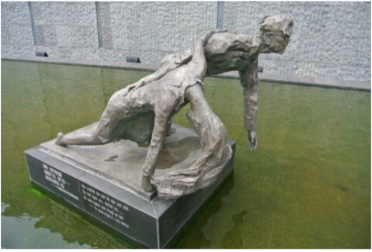
A sculpture in Nanjing Massacre Museum
Run! Run! Devils are chasing us…

Slide 21
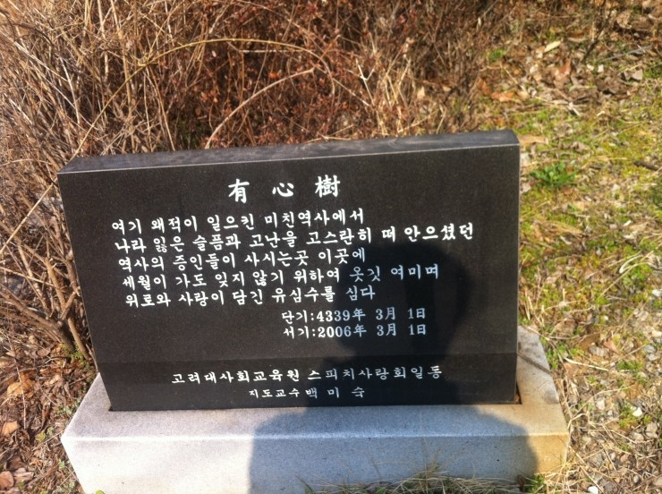
A monument in House of sharing
In this crazy history done by enemy Japan…

Slide 22
3. What would you change about the memorial?
Would you like to remove something?
Is anything missing?

Slide 23
Thank you all!

